Slide 1

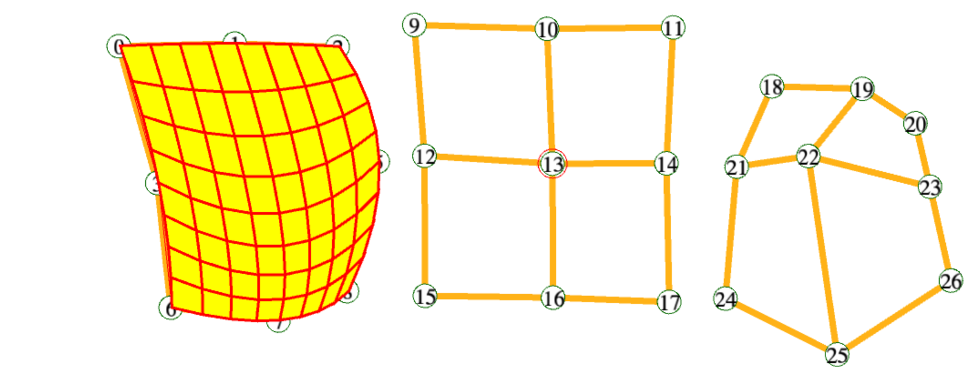
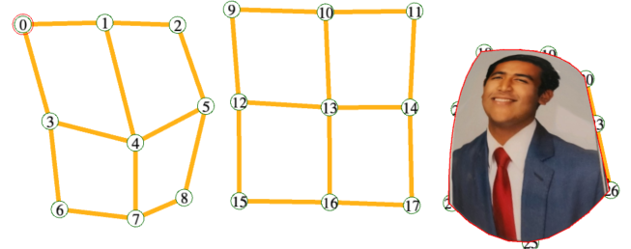
Animated Image Warp and Morph
CS3451 FALL 2020 PROJECT 3
Saumya JAIN

Slide 2
Phase A: PROBLEM = Tri-Quadratic Warp Animation
Given an array of control points, define a continuous and smooth point-valued function F_{c} ( t , u , v ) that interpolates 27 constraints: F_{c} ( i/2 , j/2 , k/2 ) = C[i][j][k] with i, j, k ∈ {0,1,2}. Implement this using parabolic interpolants. Define the mapping of (u, v) onto the control grid to track the mouse movement over time.
COMMENTS:
In order to accurately implement F_{c} using parabolic interpolants, we assume the following:
PNT C[3][3][3] is the array of control points.
The knots for the parabolic interpolants are 0, ½, and 1
Here, there is no ambiguity.

Slide 3
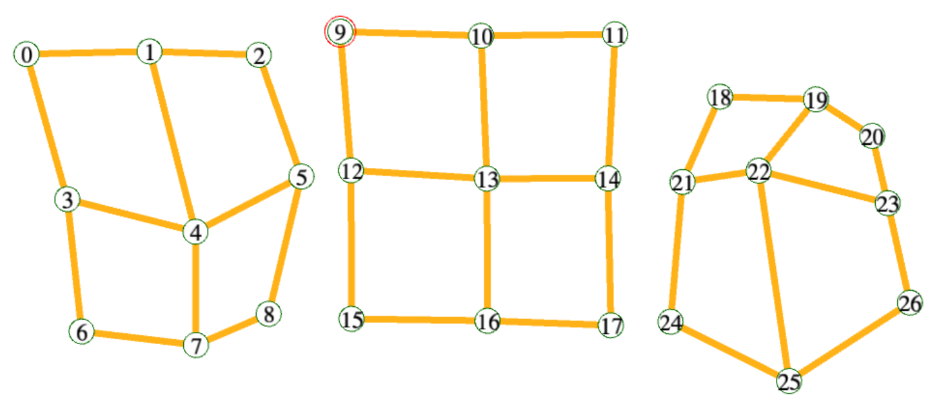
PHSE 1: Solution outline
We can compute the required function and mapping using interpolation.
In the 2-D control grid, for each point in the first subarray (C[0]), interpolate between the corresponding points in the second and third subarray (C[1] and C[2])
If given a function L that linearly interpolates between two points, we can use the quadratic Neville interpolation L(0, L(0, C[0][j][k], 0.5, C[1][j][k], t), 1, L(0.5, C[1][j][k], 1, C[2][j][k], t), t)

Slide 4
PHSE 1: Solution outline
Now, given the normalized values of (x, u) and (y, v), we need to interpolate between C[i][j][k] for k = 0, 1, 2 with time u. After this, we again need to interpolate between the resulting points and time v. This is essentially the mapping of (u, v) onto the control grid.
We can calculate the needed points like so:
A = L(0, C[0][0][0], 0.5, C[0][0][1], 1, C[0][0][2], u)
B = L(0, C[0][1][0], 0.5, C[0][1][1], 1, C[0][1][2], u)
C = L(0, C[0][2][0], 0.5, C[0][2][1], 1, C[0][2][2], u)
X = L(0, A, 0.5, B, 1, C, v)

Slide 5
Phase A: Solution math
We can compute if the created interpolation is the required parabolic interpolation between points A, B, and C.
The interpolation is given by L(a, L(a, A, b, B, T), c, L(b, B, c, C, t), t) in its general form, where a, b, and c are knots.
Let’s say that by linearly interpolating between the points A and B, we create point M. Then, interpolating between B and C, we create point N. This results in two linear paths.
So, by linearly interpolating between M and N using the same variable of time, we get a second degree function as a result.
This is the required parabola.

Slide 6
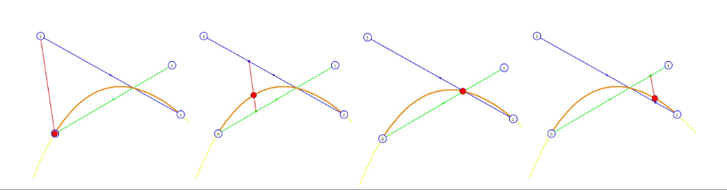
Phase A: Solution math

Slide 7
Phase A: Solution math
We can compute if the interpolations calculated result in the mapping of (u, v) onto the control grid.
The series of interpolations are:
A = L(0, C[0][0][0], 0.5, C[0][0][1], 1, C[0][0][2], u)
B = L(0, C[0][1][0], 0.5, C[0][1][1], 1, C[0][1][2], u)
C = L(0, C[0][2][0], 0.5, C[0][2][1], 1, C[0][2][2], u)
X = L(0, A, 0.5, B, 1, C, v)
Here, each of A, B and C is on the horizontal edge of the control grid. The knots here are 0, 0.5 and 1 respectively. This means that the interpolation scales uniformly across A, B, C (between 0 and 1).
We are given the relative position of u on each edge when we interpolate up to time u across the horizontal edges. This is because u is the normalized value of x for a certain position.
So, when we interpolate across A, B, and C, we get the warped y-axis by x = u on the grid.
Hence, interpolating this to a time v across A, B, and C is the mapping of (u, v) onto the grid.

Slide 8
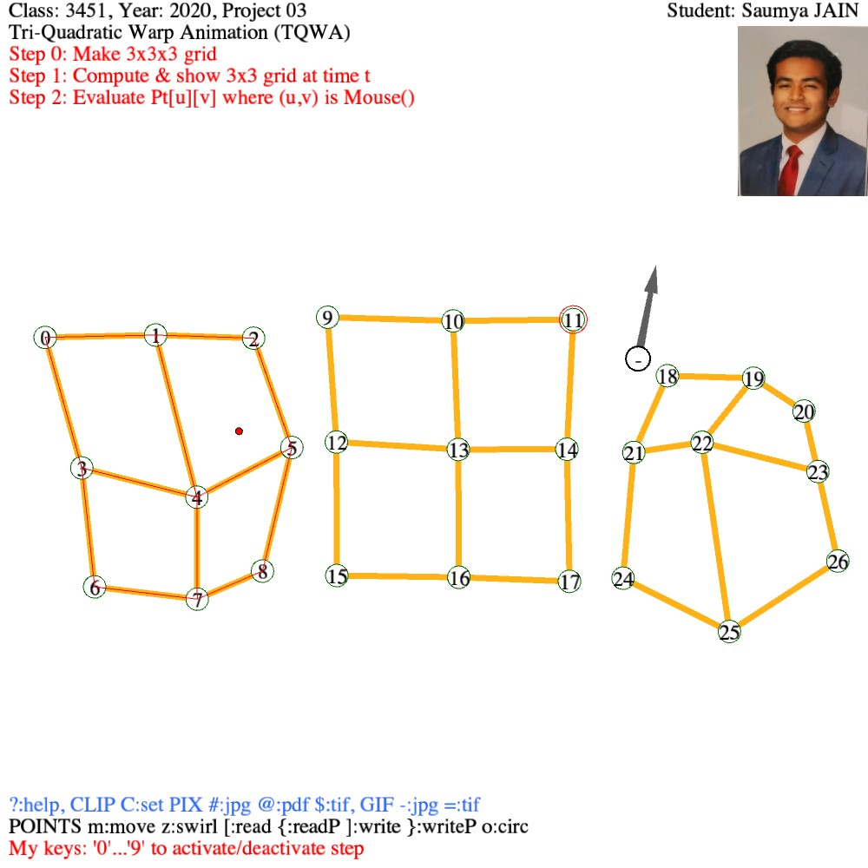
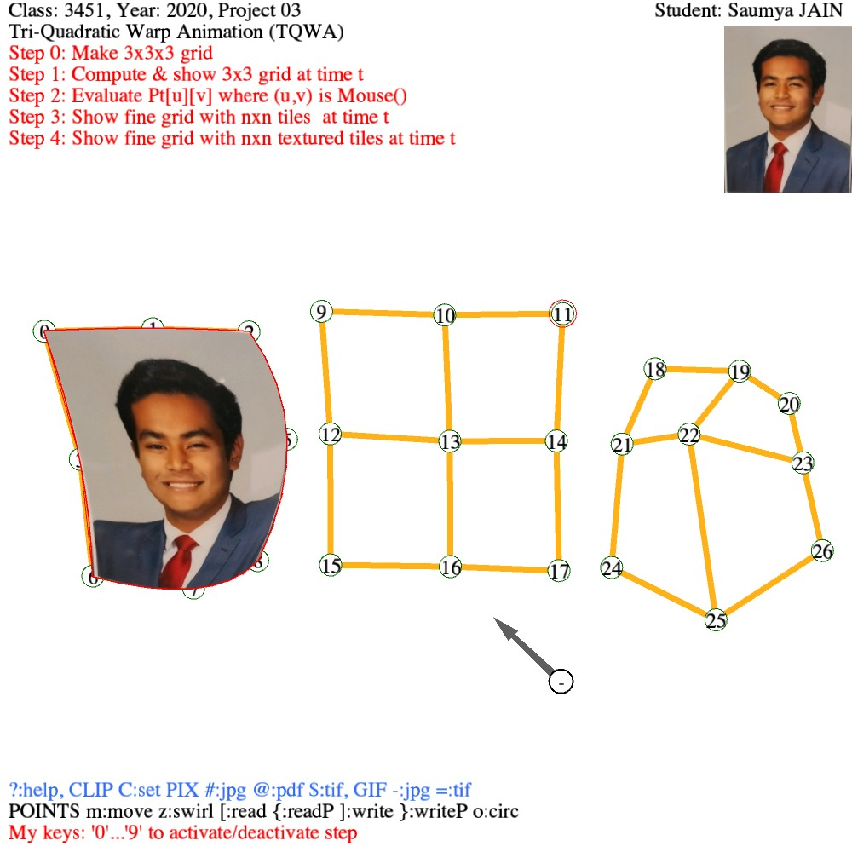
Phase A: Results and limitations of your implementation
DISCLAIMER, LIMITATIONS:
This solution always works.

Slide 9
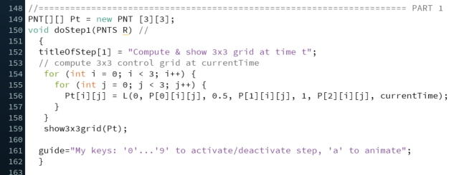
Phase A: Code and whole screen shot of result

Slide 10
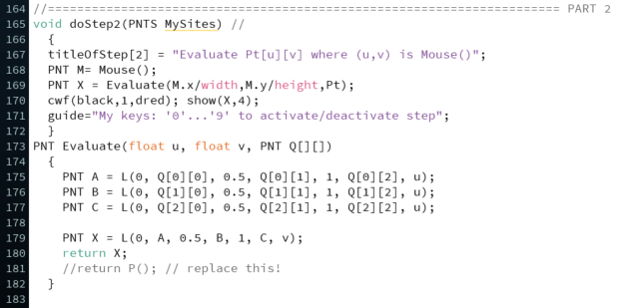
Phase A: Code and whole screen shot of result

Slide 11
Phase A: Code and whole screen shot of result
The code from the previous slides outputs the following (Grid + Mouse location) :

Slide 12
Phase A: Code and whole screen shot of result
We can further enable Steps 3 and 4 for an animated face warp representation

Slide 13
Phase A: GIF

Slide 14
Phase A: Sources
I had no preexisting knowledge on parabolic interpolations.
I learned about the topic from:
http://fourier.eng.hmc.edu/e176/lectures/NM/node25.html
https://en.wikipedia.org/wiki/Successive_parabolic_interpolation
https://www.youtube.com/watch?v=noczK51tOgE
Lecture

